Slide 1
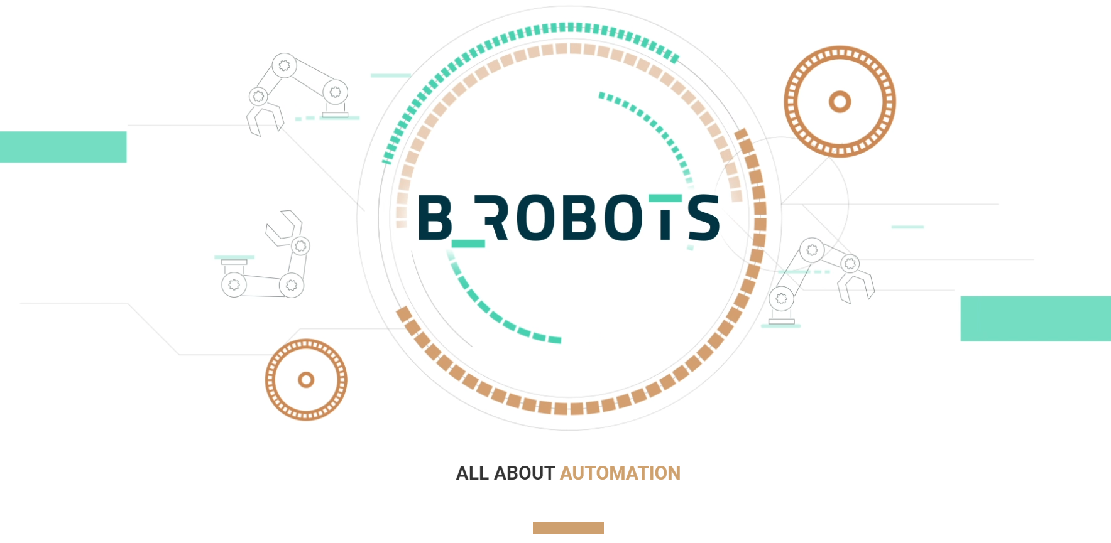

Project Phoenix
Mohammad Azish
2023 Internship

Slide 2

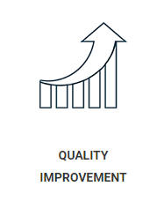
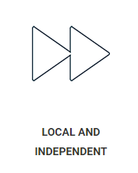
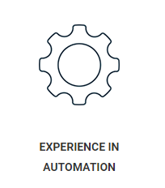

Project Plan – Who?
B_Robots is an automation company
All about saving costs for companies
Improving business processes
Unique solutions per customer

Slide 3


Project Plan – What?
Train and develop a LLM for E-Mail Classification
Deploy & Use via an Automation Robot
Help filter 1000s of daily E-Mails
Will be used for a company that deals with Leak Detection
Possible Data Extraction?

Slide 4


Project Plan – Why?
No need to check 1000 E-Mails
Urgent mails are seen faster!
Junk/Spam/Phishing E-Mails can be avoided
Can replace a rented service currently used by B_Robots?

Slide 5


Tools
Currently working on Falcon-7B
Training the model on Leak and Non-Leak E-Mails
Amazon SageMaker Notebook Instance
HuggingFace Transformers Libraries
Utilizing Model Quantization

Slide 6
Management & Tracking
Daily Stand-Up meetings
Project is on the company Jira board
Weekly Updates to Internship Supervisor
Currently shadowed by 2 employee’s
Internship Mentor

